Slide 1
Recitation 6

Slide 2
Info
Jon Rutkauskas
Recitation: Tue 12-12:50
Office Hours: Tue 11-11:50 Thur 11-12:50 SENSQ 5806 (additional hours by appointment if needed)
On discord: @jrutkauskas
By email: jsr68@pitt.edu
Github: https://github.com/jrutkauskas/spring2019-449-rec
Ask me any questions you have!!!

Slide 3
Exam 1
Exam 1 is next week! I won’t see you again before it (outside of OH), so we’ll spend some time today covering questions you may have, and I can also answer questions about Project 2

Slide 4
Warmup Polls

Slide 5
Quick Freebie For Project 2
When your code crashes in the delightfully colorful bigdriver, it can sometimes leave your terminal printing in strange colors
I have a quick C program that will reset your terminal to normal colors if this is a problem for you.
Posted on Github under Recitation 6 as resetcolors.c

Slide 6
Code
#include <stdio.h>
int main()
{
printf("\e[0m");
return 0;
}
As a (completely unnecessary) side note, these ANSI Escape Sequences can be pretty cool and fun

Slide 7
So Project 2…
Due by midnight Wednesday. Please make sure to get working on it.
This is a debugging-heavy project and it’s hard to judge how much time you need.
Please don’t wait until the last minute and start panicking at 11:20pm (though we’ve all been there).
I won’t have office hours until Thursday but I’m available on Discord or by email!

Slide 8
Project Notes and Suggestions
Make sure you are using the Makefile and that it compiles your code correctly (it’s part of your grade)
Jarrett suggests this but I want to double suggest it: Please make small functions to help out and help organize your code, even if you only call them in one place.
E.g., functions for removing a block from the linked list, splitting a block, expanding the heap, coalescing blocks, coalescing with the block to the left, to the right… etc. You get the picture
Makes it so much easier to test, debug, and keeps your code organized
If you’re really stuck with where something is going wrong, consider drawing some test cases out on paper and compare with what’s happening in gdb
Actually write your own tests in mydriver.c

Slide 9
Linked Chain/list Help
By the way, if you still have any confusion about how to properly deal with linked chains/lists, here’s a link to some lecture notes detailing the basic operations and some (java) code for implementation
https://www.cs.cmu.edu/~adamchik/15-121/lectures/Linked%20Lists/linked%20lists.html

Slide 10
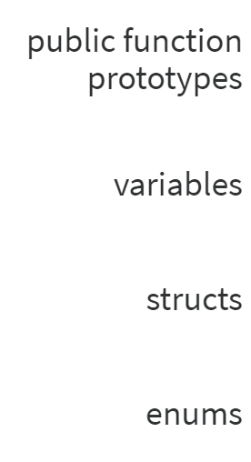
Quick Review Question: Which of these should Not go in a header file

Slide 11
Quick Review Question: Which of these should Not go in a header file
We shouldn’t put any variables, function definitions, or anything we want to keep private in headers
Headers are kind of similar (in form, not purpose) to interfaces in Java (Remember 445?)
No code, no data, just definitions Though, you can have structs, enums, and #defines in them

Slide 12
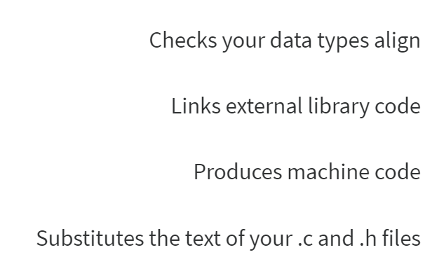
Quick Review Question: What does the preprocessor do?

Slide 13
Quick Review Question: What does the preprocessor do?

Slide 14
Quick Review Question: What does the preprocessor do?
The preprocessor only does text substitution
Data type checking is done by the compiler
The linker links the external library CODE
Though the preprocessor will #include the header files for external libraries
The compiler produces machine code

Slide 15
Exam Review time
Ask me literally anything about course material – Old-fashioned style
Remember I was sitting in these very seats 2 years ago.
If you don’t care about the exam (gasp!) then you can work on Project 2. I’ll be around after to answer questions with that.
Other good practice: I post all the questions from this class on Github; you can go back through and review them.

